Slide 1
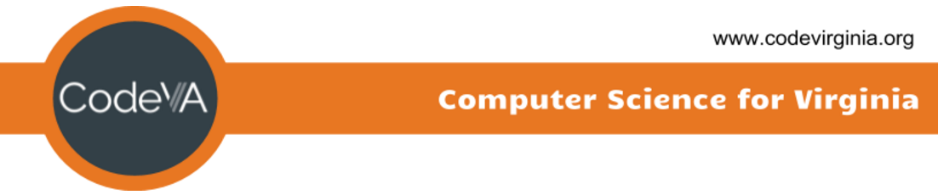
Coding Lesson 5
Functions/Procedures
Elementary Coaches Academy

Slide 2
Log into your Scratch account
https://scratch.mit.edu

Slide 3

Warm up
Open the starter file
https://scratch.mit.edu/
Run the program by clicking the flag icon

Slide 4
Definition: Function
A function is a named portion of a program that performs a specific task
okay...

Slide 5
Why Functions?
Computer scientists are some of the most hard-working lazy people out there.
Functions are built so that code can be repeated without having to duplicate it

Slide 6
Functions
Functions are also referred to as procedures, subroutines, and blocks
In Scratch, the block-based programming language, you can make your own block!

Slide 7
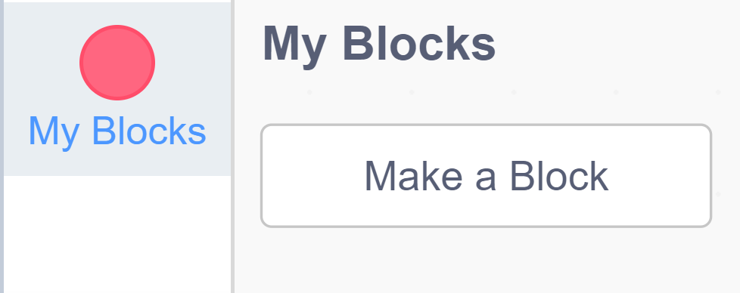
Lab Lecture
Click the My Blocks menu on the bottom of the Code pane, then click Make a Block

Slide 8
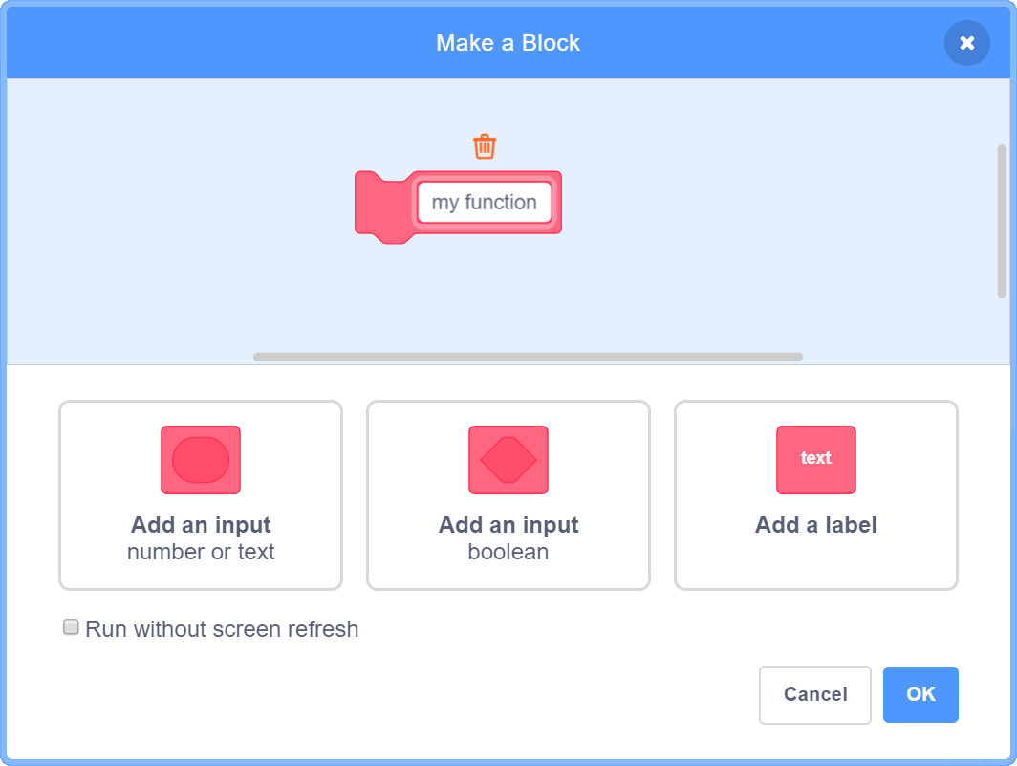
Make a Block
Here, give your block (function) a name. The name of a function usually describes what the function does.

Slide 9
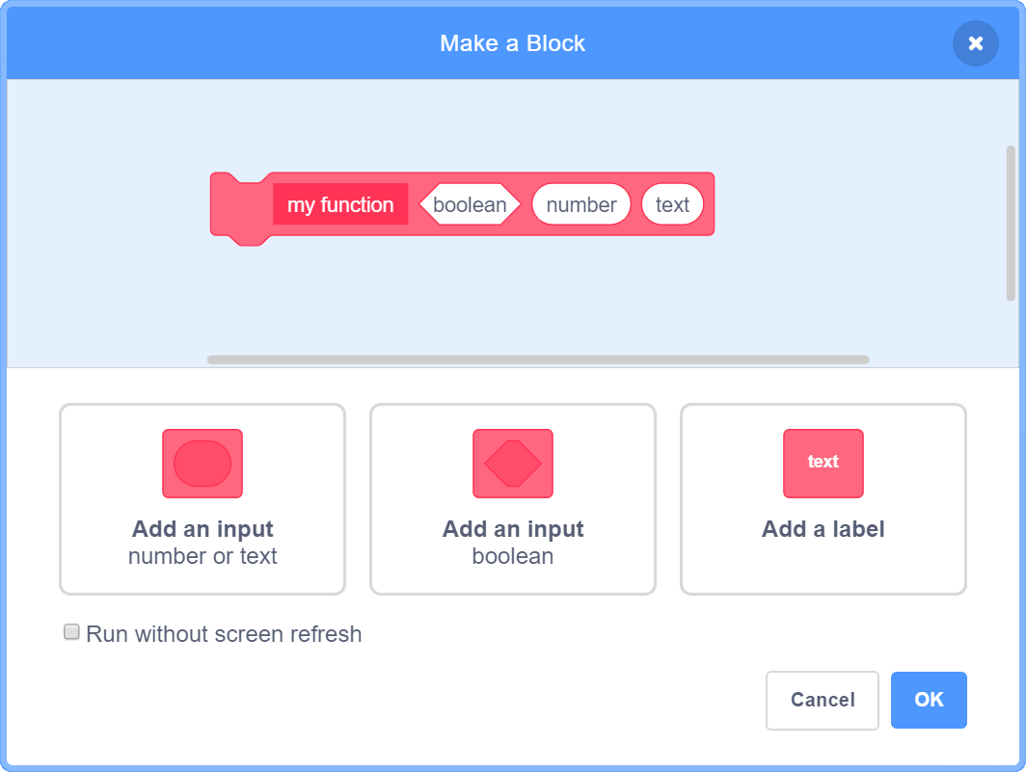
Make a Block

Slide 10
Practice Exercises
Mild - perfect for beginners
Medium - expanding your skills
Spicy - looking for a challenge?

